Slide 1
Evidence Synthesis Generation: Renal Care Package
Center for Epidemiological Modelling and Analysis

Slide 2

Renal Care Package
The Benefits Package and Tariffs Advisory Panel (BPTAP), gazetted in April 2025 and hosted by CEMA, commissioned this work to generate the clinical evidence base for the renal care package. The findings of this systematic review and meta-analysis are intended to directly inform BPTAP's appraisal of whether these interventions should be included in SHIF's benefit package, and at what tariff.
Rapid systematic review using RCEMA
Main variables on clinical effectiveness included; survival rate, hazard rate, odds ratio, relative risk, hospitalization rate.
Meta analysis was done, especially for survival rate.

Slide 3


Renal Care Package Proposed Interventions
1
2
3
4
INTERV-2026-03-04-0001
INTERV-2025-11-05-0002
INTERV-NRFH-2026-04-0008
INTERV-NRFH-2026-04-0007
Acute Kidney Injury Benefit Package
Increase Number of Covered Dialysis Sessions to Three Per Week and Provide Medication
Renal - Peritoneal Dialysis (PD)
Renal - Haemodialysis Tariff
5
6
7
8
INTERV-2025-11-04-0008
INTERV-SHA-2026-04-0006
INTERV-NRFH-2026-04-0009
INTERV-2025-12-15-0001
Drug Allocation: Immunosuppressants for Renal Transplant Patients
Post-Kidney Transplant scope
Transplant Services
Updating SHA Input in Chronic Kidney Disease Treatments and Management

Slide 4
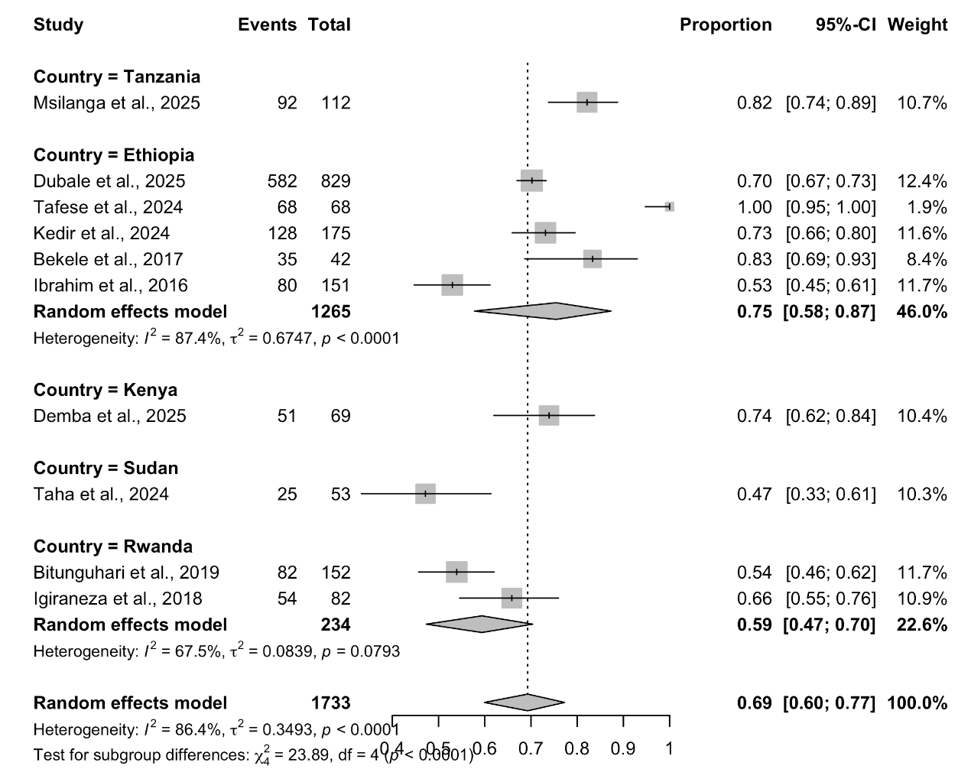
1
INTERV-2026-03-04-0001
Acute Kidney Injury Benefit Package
Justification: No dedicated AKI package currently exists within the SHA benefit framework. AKI is frequently reversible and clinically distinct from chronic kidney disease; early and aggressive management is critical to prevent progression to end-stage renal disease.
Research Question: In patients with Acute Kidney Injury (AKI), what is the clinical effectiveness and cost-effectiveness of renal replacement therapy compared with standard care or alternative management strategies in improving renal recovery, reducing mortality, and preventing progression to chronic kidney disease and end-stage kidney disease?
Pooled survival probability of patients undergoing hemodialysis - 69% [60%;77%]
Pooled survival probability of patients undergoing peritoneal dialysis - 80% [57.22, 92.29]

Slide 5
Burden of disease analysis snapshot for mortalities reports

Slide 8
Justification: The Kenya Renal Association advises that two dialysis sessions per week reflects the applicable standard based on local evidence. Increasing to three sessions per week would represent a material change in utilisation. A budget impact assessment is required before any change to the current provision.
Research Question: In patients with Chronic Kidney Disease stage 5 (CKD G5D) and End-Stage Kidney Disease (ESKD) requiring maintenance dialysis in Kenya, what is the clinical effectiveness and cost effectiveness of increasing dialysis intensity compared with standard dialysis regimens in improving survival, quality of life, dialysis adequacy, and other clinically important outcomes?
2
Meta analysis - 29 studies - incremental or conventional HD - pooled mortality rate - OR 0.87 [0.72-1.04]. In a meta-analysis of 29 studies, there was no significant difference in mortality between patients treated with incremental or conventional HD [OR 0.87 (95% CI 0.72–1.04), P = .124]. This finding was consistent across observational studies and RCTs. (Kullaya Takkavatakarn. et al.,2023)
Meta analysis - 10 studies - incremental or conventional HD - pooled hospitalization rate - Hospitalization was significantly lower in patients treated with incremental compared with conventional HD (Kullaya Takkavatakarn. et al.,2023) [OR 0.44 ( 0.27–0.72)]
Meta analysis - 9 studies - incremental or conventional HD - pooled cardiovascular events [OR 0.67 ((0.43–1.05)]. There was no statistically significant difference in cardiovascular events between incremental and conventional HD (Kullaya Takkavatakarn. et al.,2023)
INTERV-2025-11-05-0002
Increase Number of Covered Dialysis Sessions to Three Per Week and Provide Medication

Slide 9
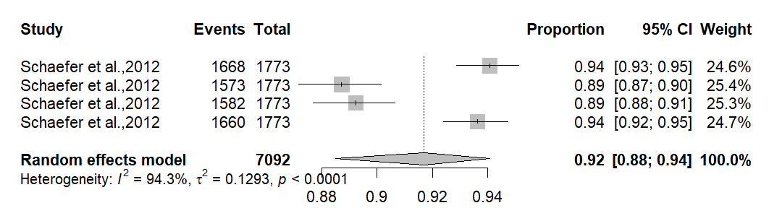
Justification: The current peritoneal dialysis allocation is KES 85,200 for 12 monthly sessions. PD fluid costs are heavily import-dependent and subject to exchange rate fluctuations. The proposal is to increase the PD allocation to KES 100,000-150,000 per cycle and to prioritise local PD fluid manufacturing as a medium-term cost-containment strategy.
Systematic Reviews
3
INTERV-NRFH-2026-04-0008
Renal - Peritoneal Dialysis (PD)
PD was associated with faster time to kidney function recovery compared to extracorporeal dialysis for AKI management (Menghrajani et al., 2026).
The risk of infection was higher among patients treated with PD than among those treated with HD, but the difference was not statistically significant (Zhifeng Wei et al., 2023)

Slide 10
Peritoneal Dialysis
Justification: The current peritoneal dialysis allocation is KES 85,200 for 12 monthly sessions. PD fluid costs are heavily import-dependent and subject to exchange rate fluctuations. The proposal is to increase the PD allocation to KES 100,000-150,000 per cycle and to prioritise local PD fluid manufacturing as a medium-term cost-containment strategy.
Research Question:
Systematic Reviews
Hazard Ratio: Peritoneal dialysis in AKI patients over two periods (2004-2014 vs 2015-2024) - 2.39 [1.16, 4.93]
Odds Ratio: Peritoneal dialysis vs extracorporeal in AKI patients - 1.26 [0.81, 1.95]
Odds Ratio: Peritoneal vs HD in diabetic kidney failure patients - 1.28 [0.92, 1.78]
Pooled survival probability of children undergoing peritoneal dialysis - 92% [88%;94%]

Slide 11
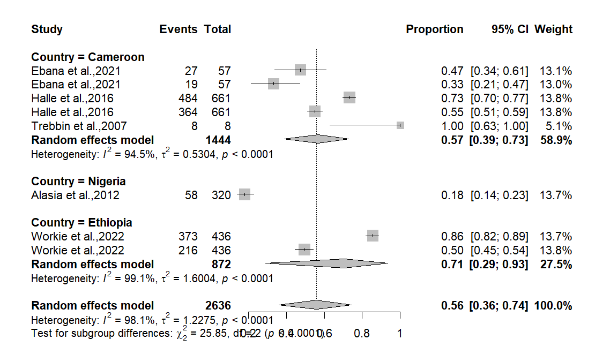
Justification: The current haemodialysis tariff is KES 10,650 per session. Itemised actual session costs average KES 11,574, driven primarily by consumables and overhead. The proposal is to revise the tariff to KES 12,000-15,000 per session to ensure sustainable facility-level delivery of dialysis services.
4
INTERV-NRFH-2026-04-0007
Renal - Hemodialysis Tariff
Pooled survival probability of patients undergoing hemodialysis - 56% [0.36;0.74]
Hemodialysis in adults with CKD - 56.73% [38.95; 72.93]
Relative risk for mortality - hemodialysis vs CRRT in CKD patients - 1.1 [0.95, 1.27]

Slide 12
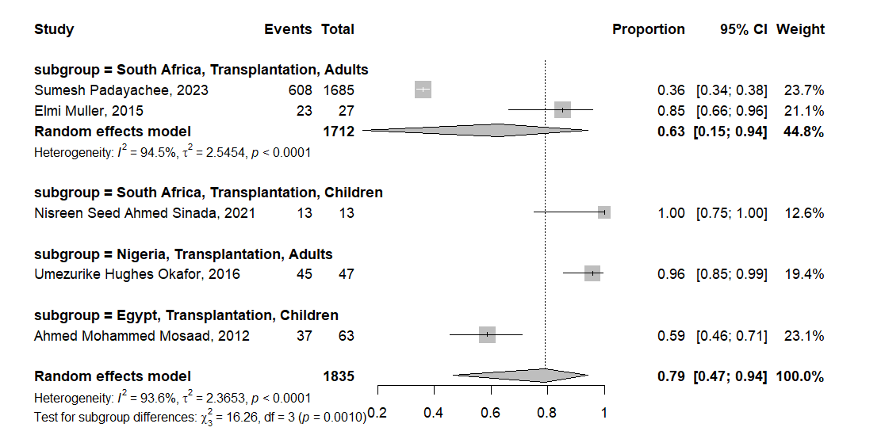
Post-Kidney Transplant Scope
Research Question:
Justification: Which immunosuppressive medicines should be covered, and at what frequency?
What is the defined test list for post-transplant monitoring (creatinine, drug levels, infection screening)?
What is the appropriate frequency schedule — early phase (monthly) tapering to clinically guided intervals?
Pooled survival probability of Patients with ESKD who underwent kidney transplant - 79% [[0.47;0.94]

Slide 13
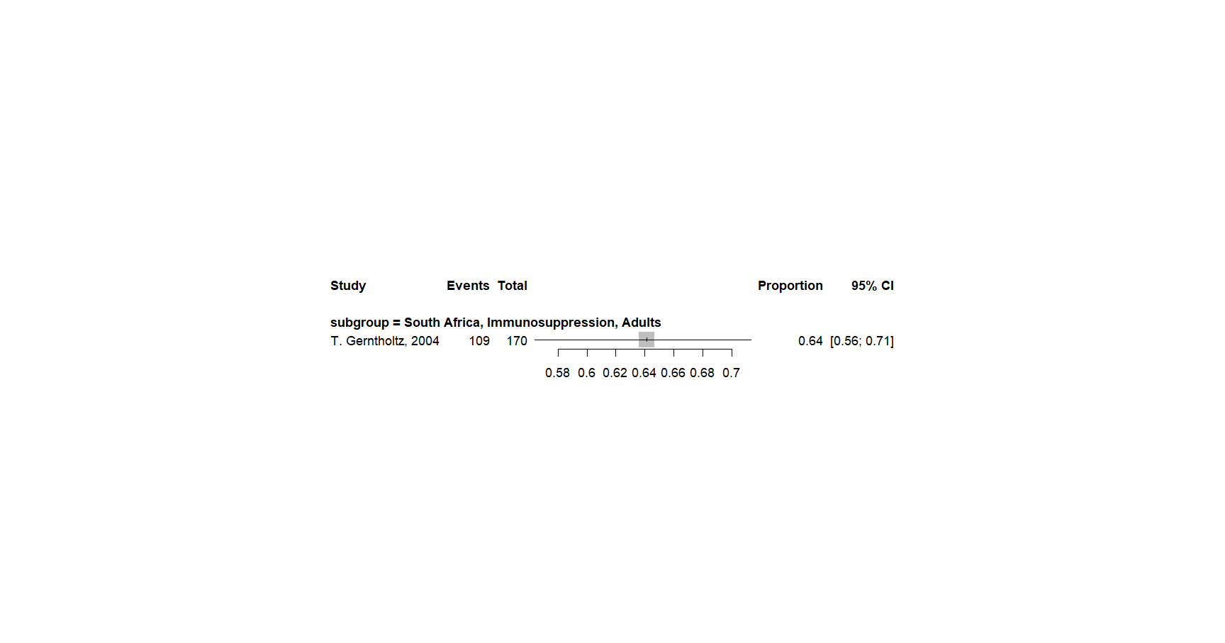
Drug Allocation: Immunosuppressants
Justification: Additional immunosuppressive drug coverage beyond the existing KES 200,000 annual limit is sought for kidney transplant patients. Non-adherence to immunosuppression due to affordability constraints increases the risk of graft failure. A costing study is required to determine the full drug cost and appropriate limit.
Research Question: What is the clinical effectiveness of immunosuppressive drugs for kidney transplant patients?
Systematic Reviews: Immunosuppressants for Renal Transplant Patients
CyA–KZ (Cyclosporin Ketoconazole) combination vs. CyA (Cyclosporin) alone - Patient survival 70% vs 64%
CyA–KZ (Cyclosporin Ketoconazole) combination vs. CyA (Cyclosporin) alone - Patient survival 45% vs 41%
IgAN patients treated with immunosuppressants/corticosteroids vs supportive therapy
Mycophenolate mofetil MIPD vs. without 91.20%
Renal transplant patients treated with immunosuppressants vs non-immunosuppressants- 1 year survival 85 vs 81
Renal transplant patients treated with immunosuppressants vs non-immunosuppressants- 3 year survival 77 vs 76
Renal transplant patients treated with immunosuppressants vs non-immunosuppressants- 5 year survival 72 vs 66

Slide 14
Transplant Services
Justification: The current transplant benefit covers: pre-transplant recipient evaluation (KES 150,000), recipient surgery (KES 700,000), donor nephrectomy (KES 168,000), and post-renal replacement support (KES 200,000/year). Actual transplant costs range from KES 1.6M to KES 2.0M. The proposal is to revise tariffs, include donor pre-transplant evaluation, and increase post-transplant immunosuppression support to approximately KES 400,000/year (approx. KES 30,000/month). Donor evaluation tariff is yet to be costed.
Research Question: Among patients with CKD who have an identified potential living kidney donor in Kenya, does donor pre-transplant evaluation improve access to transplantation and patient outcomes?
Survival rate of living donors; 93% [0.82;0.97]

